Slide 1

Movie Trailer MatchUp™
A synthesis of cinematic Desires
Born of a passion for perfection

Slide 2
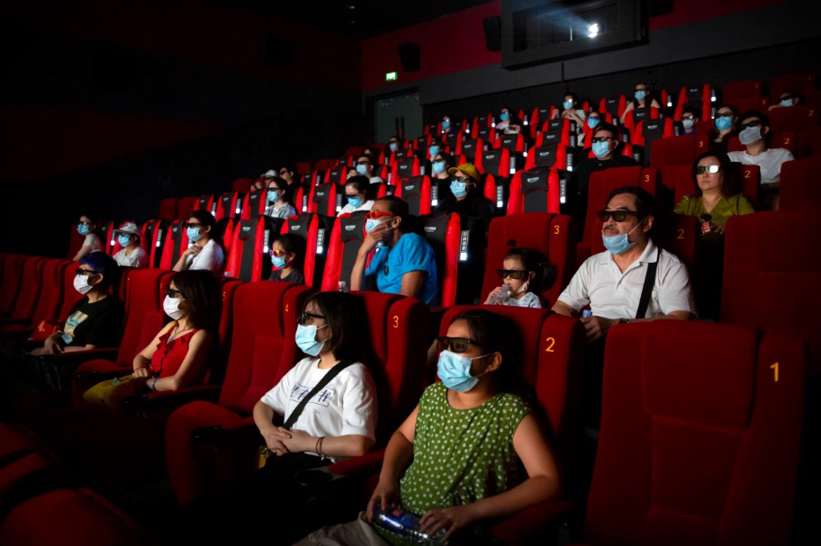
In these uncertain times...
...more and more of us are unable to enjoy the past-times that we once took for granted. Bars and restaurants, stadiums, musical venues and theaters, they are all closed or operating at drastically reduced capacities.
And of those whose favorite movie theaters have reopened, or are planning on reopening soon, many are choosing to forego risking their lives, or the lives of their loved ones, sitting in a cramped indoor space with sticky floors and a bunch of yahoos who can't agree on how to wear a mask...

Slide 3

…but the story isn't entirely bleak...
...because Americans are a resilient and adaptable people, capable of making the best out of any situation. When a virus tries to take away our movie theater, we stand tall, sit down on our couches, and bring that theater into our living rooms.
Since the pandemic began media consumption is at an all-time high. Films like Mulan and Bill & Ted Face the Music are going straight to streaming where they are devoured immediately. Quenching the media-thirst of an increasingly pliable and neurotic clientele is inspiring both the creators and distributors of media to innovate in order to capitalize on an ever-increasing demand.

Slide 4

Enter: Movie Trailer MatchUp.
Behind Movie Trailer MatchUp™ lies a plucky team of young developers connected by a deep desire to make finding their favorite movie trailers just a little bit easier. Their application creates a hub of sorts where a user is able to access a variety of movies associated with their search query and have instant access to the most relevant movie trailer associated with each result. It’s a great way to discover new content related to your favorite movie franchises, and a fun way to spend the afternoon when you’re stuck indoors!

Slide 5
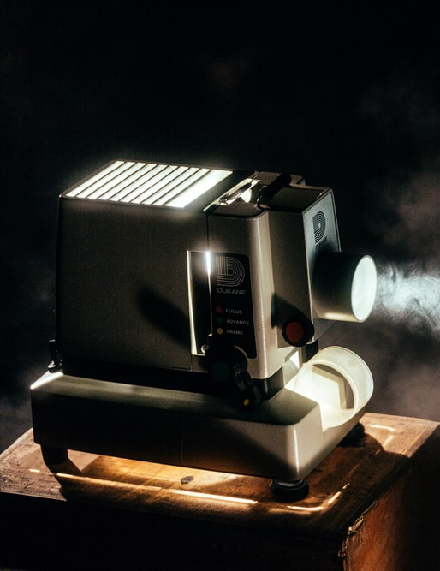
Concept
FIRST the user enters their chosen movie or television series into the search bar.
THEN they are provided a list of eight results related to their search.
EACH of the results includes the relevant title, year, and poster.
WHEN the user clicks on a poster they are shown the most relevant movie trailer associated with their choice.

Slide 6

The Process
APIs Used
OMDB
Youtube
Developers
Team Leader
Daniel Soledad
Frontend
Rachel Vallejos
Akarin Jantachotivongs
Backend
Michael Frisch
Keenan Reed
Challenges
Far too many hours were spent resolving GitHub conflicts.
Learning to communicate clearly, especially while you’re having trouble grasping a difficult concept or technique, was tough at times.
Success
Team chemistry and the open sharing of ideas were crucial to the completion of the application.
Daniel, having the strongest overall grasp of the necessary coding languages, was thrust into the roles of both tutor and lead developer. He performed well and grew noticeably as an educator over the course of the project.

Slide 7
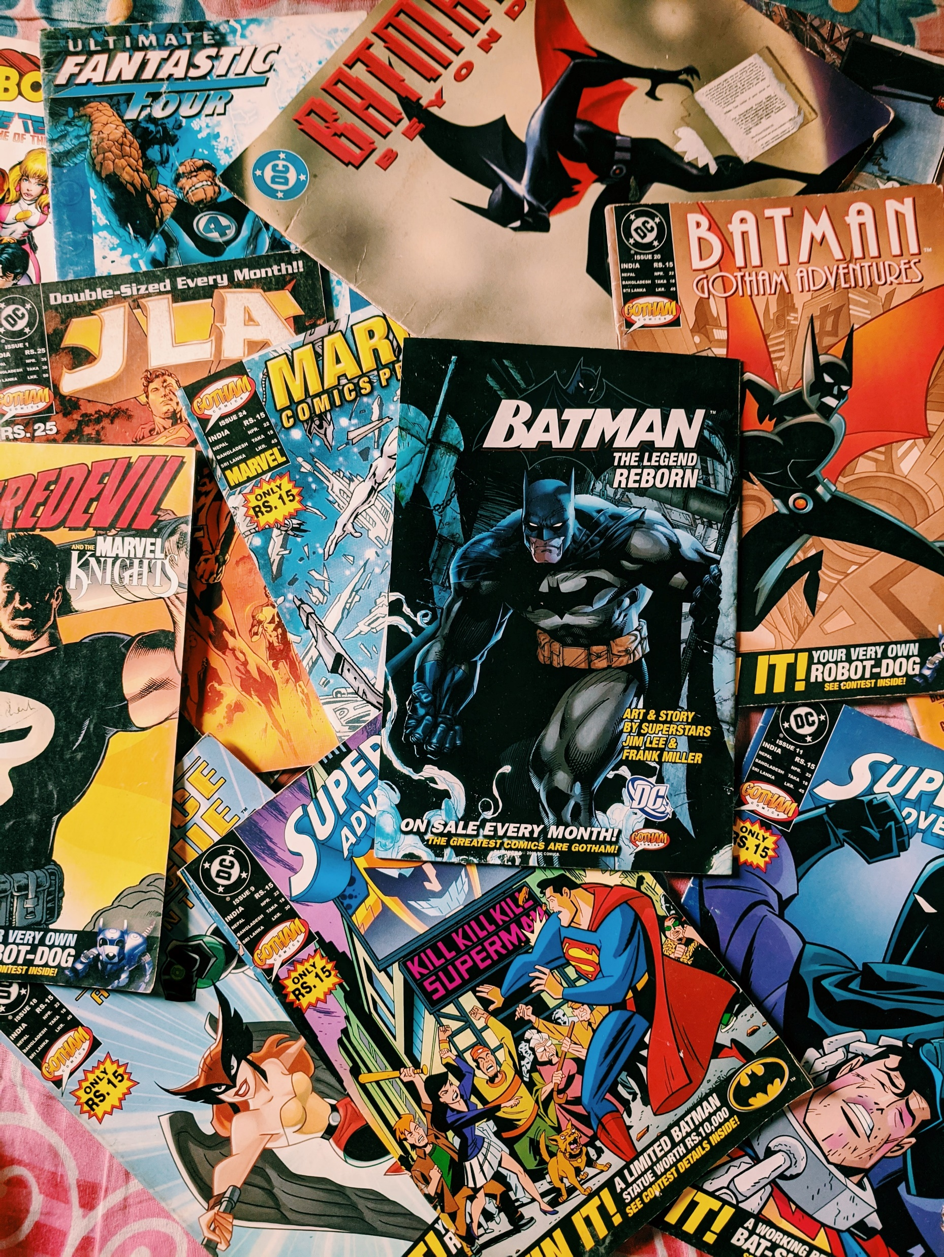
Direction for Future Development
In addition to movie trailers we would like to return relevant merchandising options such as comics, clothing, books, and toys.
If the user enjoys a trailer and wants to watch the full-length film, we want to make that easier for them by providing options describing where it can be found (Hulu, Netflix, YouTube, Amazon Prime, etc.)
When the pandemic is over and theaters reopen we plan on being ready and waiting to assist them in finding the nearest theater and facilitating their ticket purchase.

Slide 8
Links
GitHub repository:
https://github.com/mfrisch87/MovieTrailerMatchUp
Deployed application:
https://mfrisch87.github.io/MovieTrailerMatchUp/

